Slide 1






Breast biomechanical modelling for the evaluation of the compression and the discomfort perception in mammography.
Thesis title:
by Mîra Anna.
5 July 2018
Industrial advisors:
Dr. Serge Muller
Dr. Ann-Katherine Carton
Academic advisor:
Prof. Yohan Payan

Slide 2
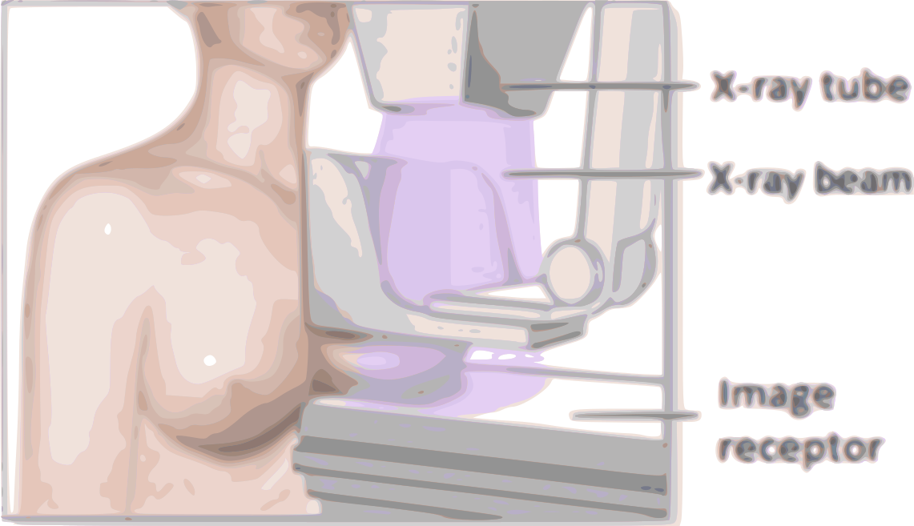
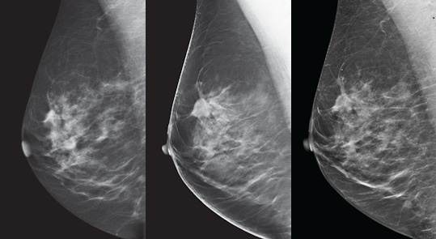
Clinical Background
Exam steps :
Breast positioning
Progressive compression
Image acquisition
X-ray tube
X-ray
beam
Reduce the patient motion
Breast compression
Reduce the absorbed dose
of ionizing photons
Image receptor
Separate overlapping
structures
reduce image
degrading scatter
Is a source of discomfort and sometimes pain
Notes:
The breast is positioned on the breast support which is also the image receptor.
The technologist will flatten the breast using a compression paddle until a nearly uniform breast thickness is reached.
The compression paddle is blocked in order to acquire the image
Women with Hight probability to develop breast cancer will participate to a breast cancer screening program. Each 2 years invited to take a mammography exam

Slide 3
Goal:
Investigate alternative breast compression methods to
Reduce the pain
Decrease the average glandular dose
Improve image quality

Slide 4
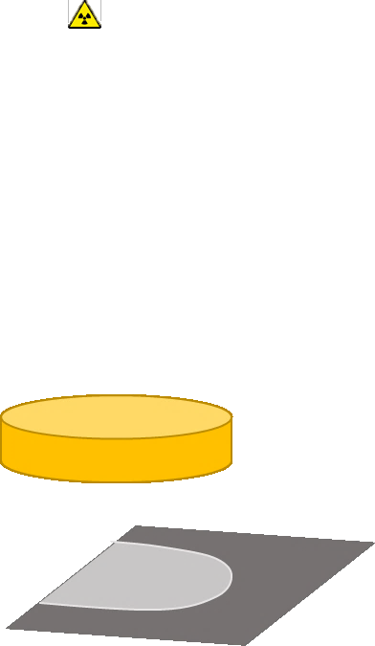
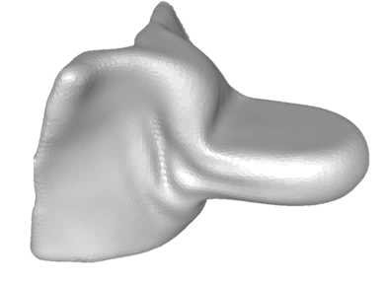
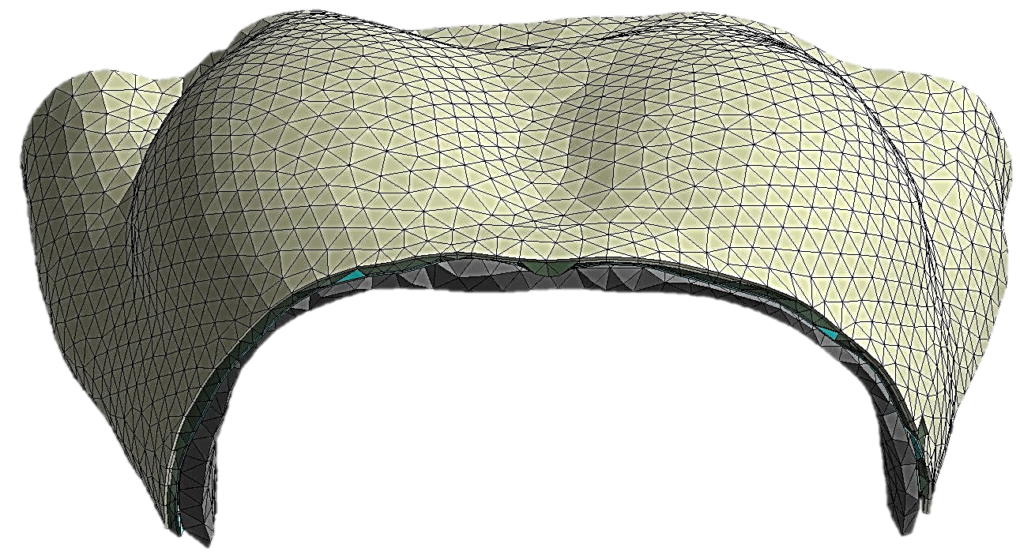
Technical approach
Image quality
Average Glandular Dose
Patient comfort
Source
Psychological and social factors:
social status
physical condition
anxiety
Physical factors:
compression force
strain intensity
Patient specific breast geometry
Numerical breast phantom
Develop a patient specific breast biomechanical model
Detector
Image simulation framework
Notes:
A cylidrical geometry was used, to perfor a study comparing the breast comression techniques a more complex breast geometry is needed
Due to physical and social factors the patient comfort is difficult to asses even in a clinical study, the results will depend on pain interpetation of each patient, and pain hystory

Slide 5
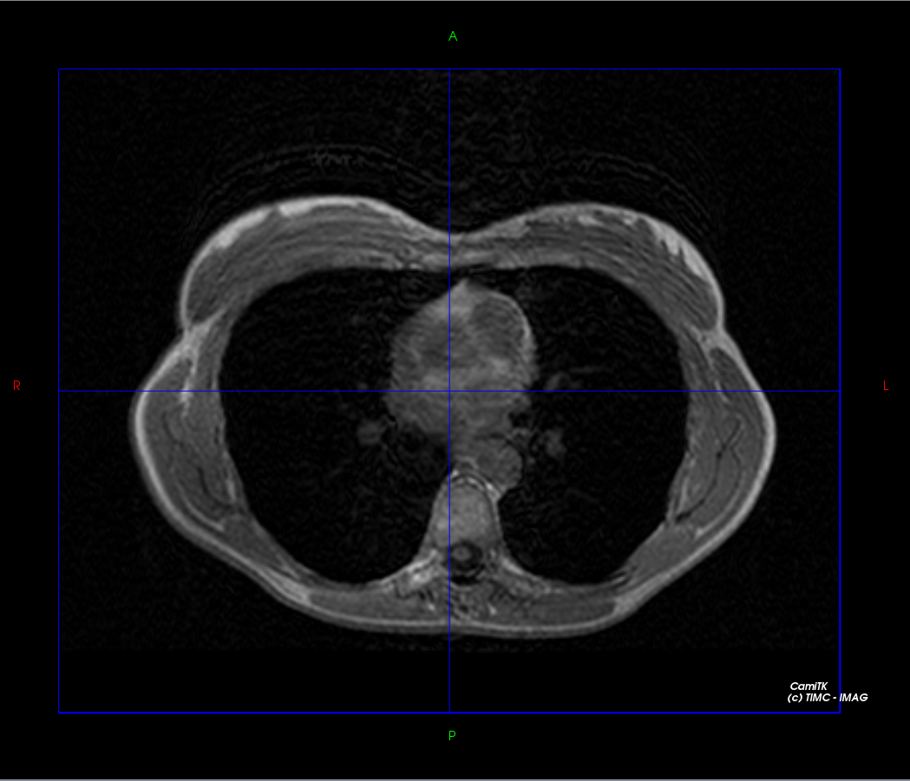
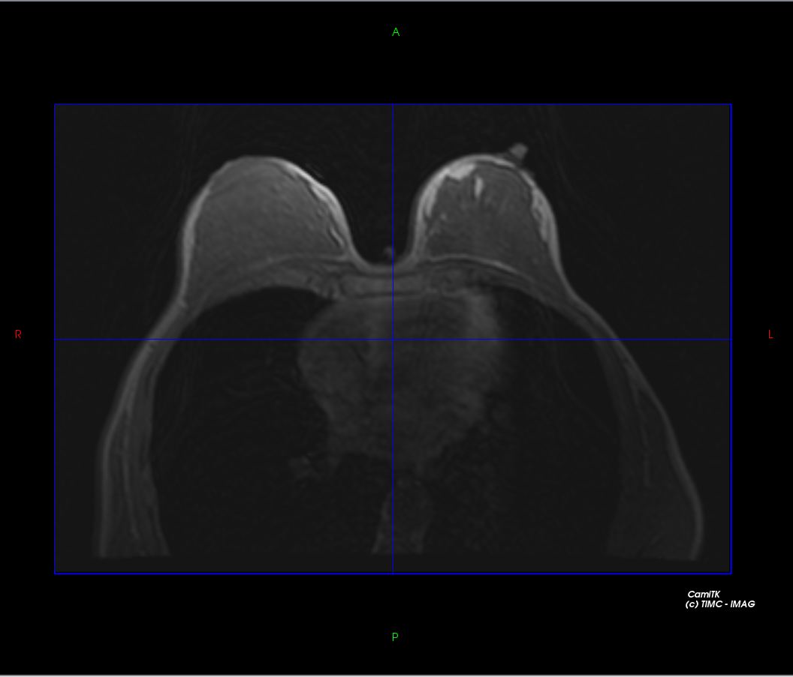
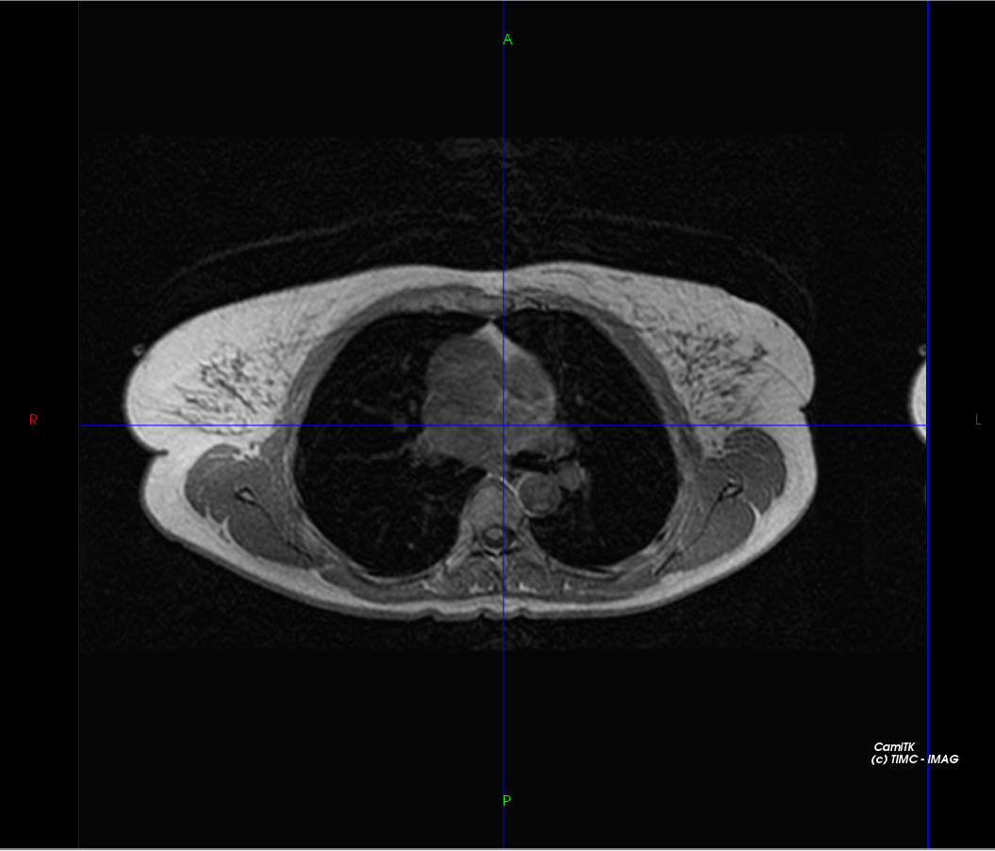
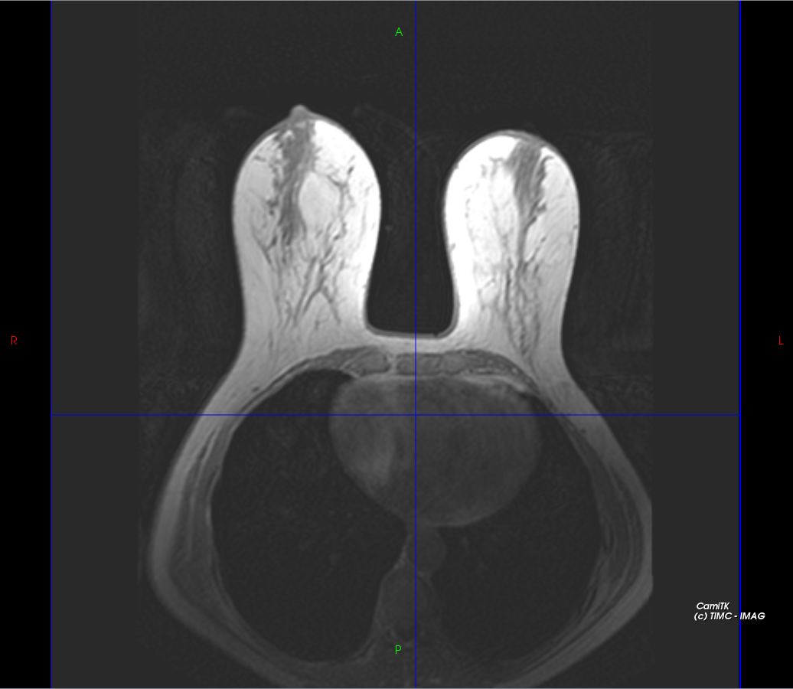
Data acquisition
MRI images of 2 volunteers
Breast compression data - from the most recent patient mammography
 | Subject 1 |  | Subject 2
 | Right breast | Left breast | Right breast | Left breast
Thick. (mm) | 47 | 42 | 50 | 49
Force (N) | 21.9 | 40.9 | 97.8 | 56.6
Volunteer 1
Volunteer 2

Slide 6
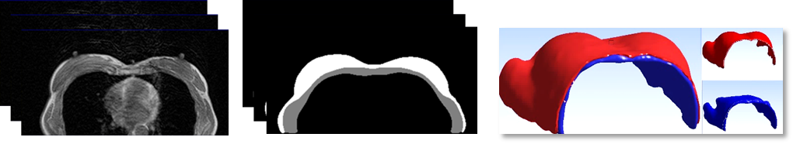
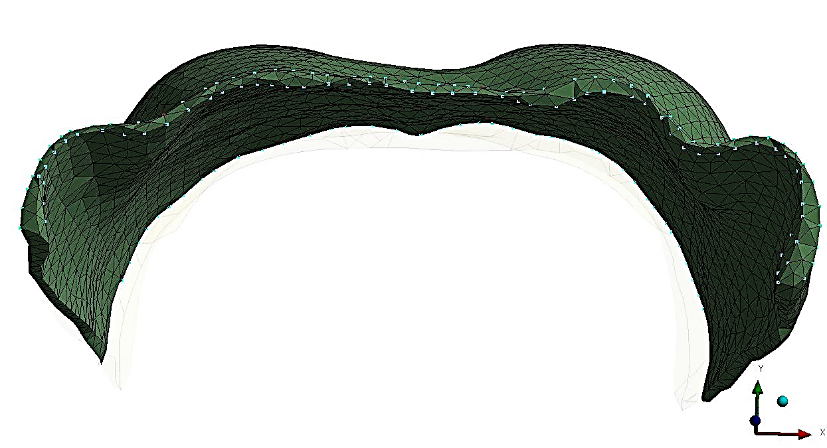
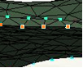
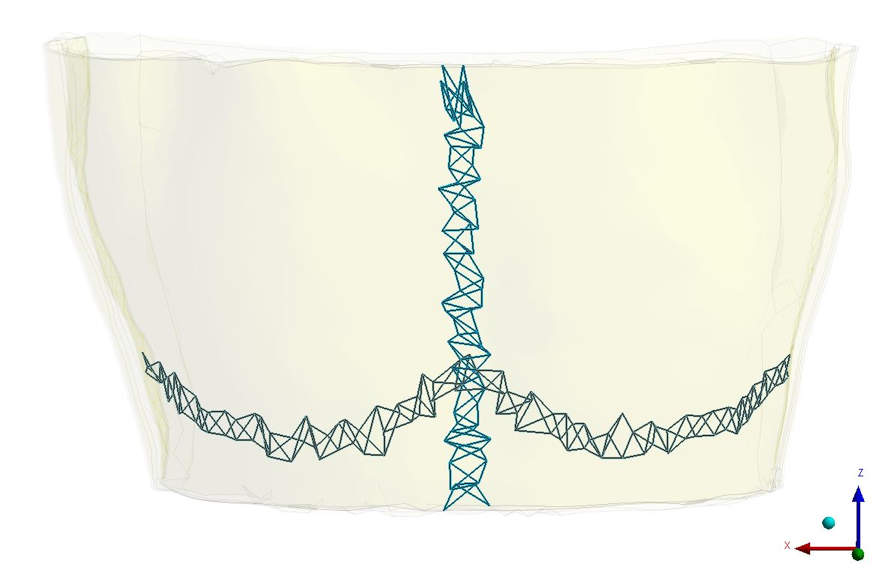
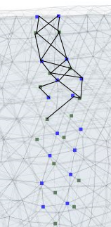
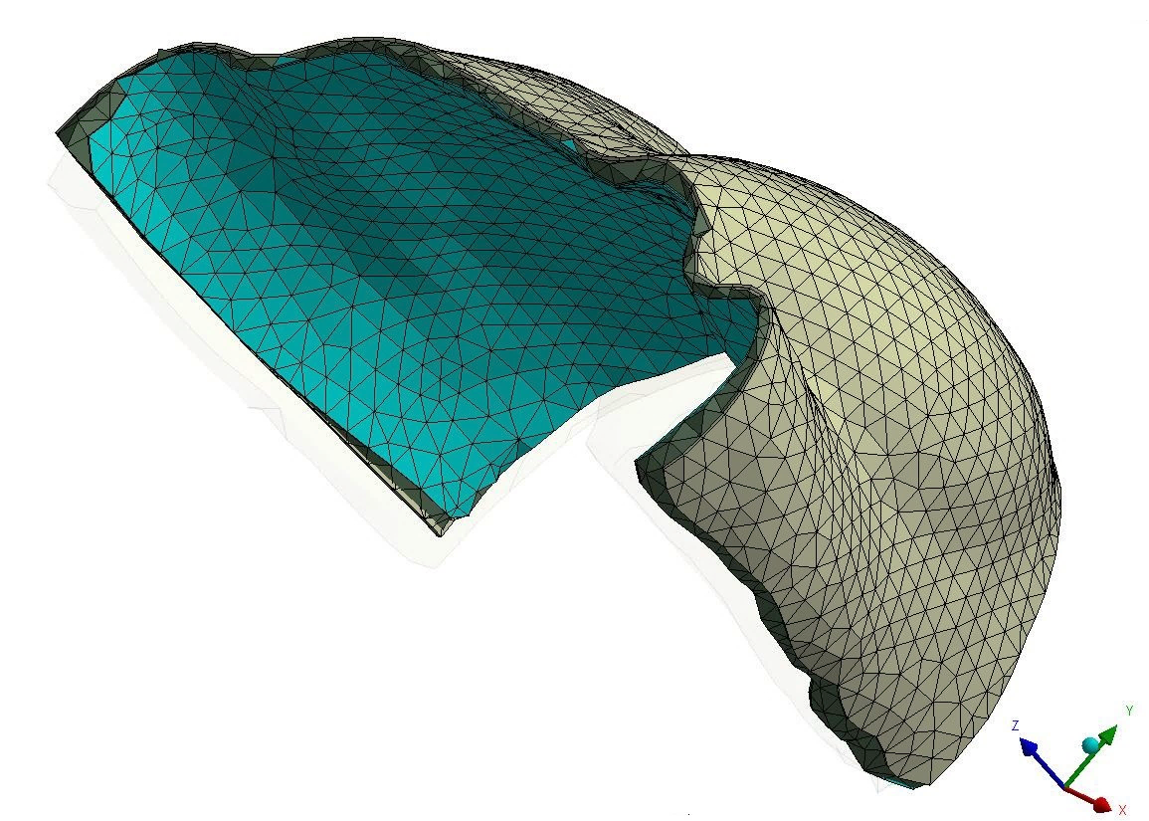
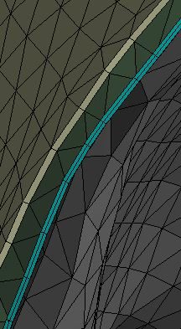
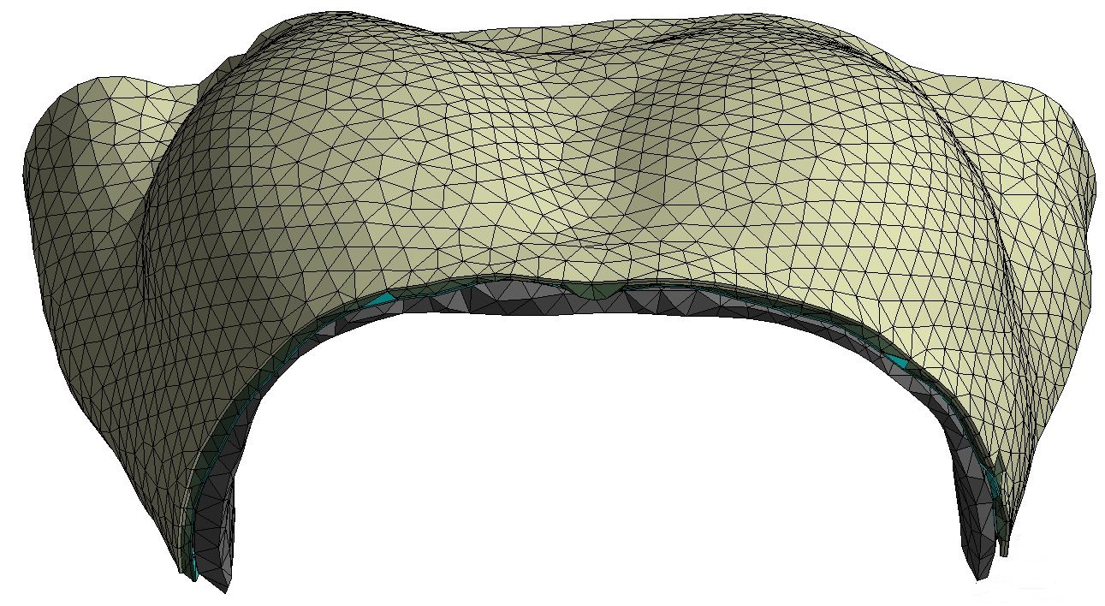
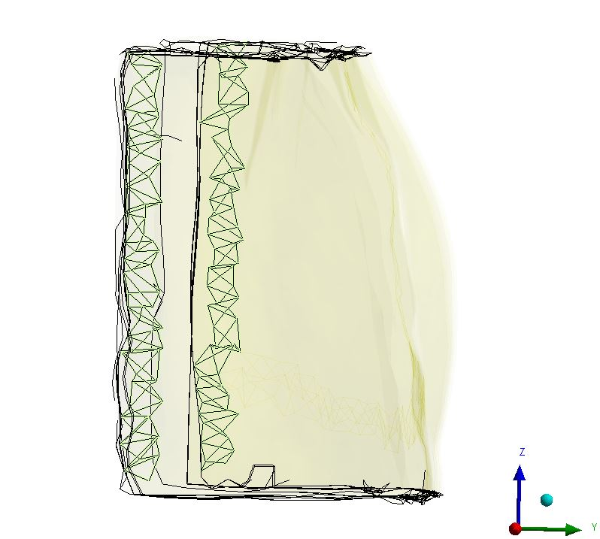
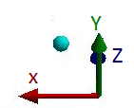
Biomechanical breast modelling
a) Image registration
Fixed nodes in Y direction
Fixed nodes in Z direction
Muscle mesh nodes
Fascia mesh nodes
b) Image segmentation
Inframammary ligament
Medial ligament
Boundary conditions
3
2
Muscle
Fascia
Breast
Skin
4
c) Geometry extraction
1
1. Mesh components 3. Dirichlet boundary conditions
2. Breast support matrix 4. Boundary conditions

Slide 7
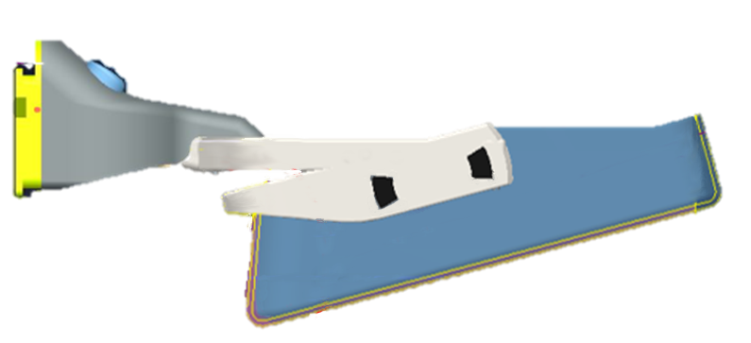
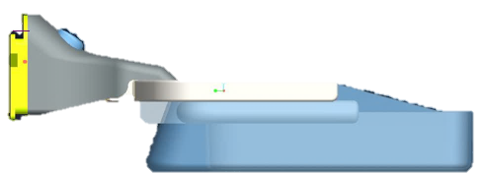
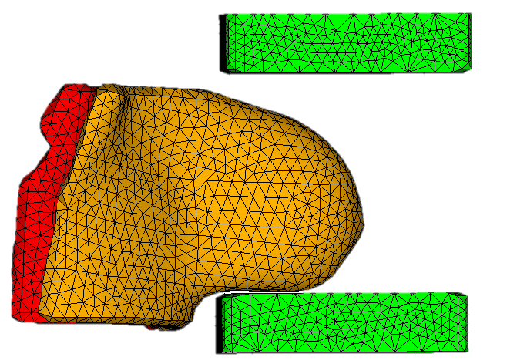

Breast compression modelling
Compression paddle models
Compression process
Breast geometry in prone configuration –modelling breast positioning step.
Initial stress (gravity loading) is neglected.
Two steps for breast compression:
Rigid paddle (SRP)
Flex paddle (SFP)
$$α$$
Rigid bodies models.
Frictionless contact.
SRP have only 1 degree of freedom.
SFP have 2 degrees of freedom
Rotational only joint element.
2.
Breast support is positioned at breast inframammary level.
Compression paddle is lowered until the target breast thickness is reached .
1.

Slide 8
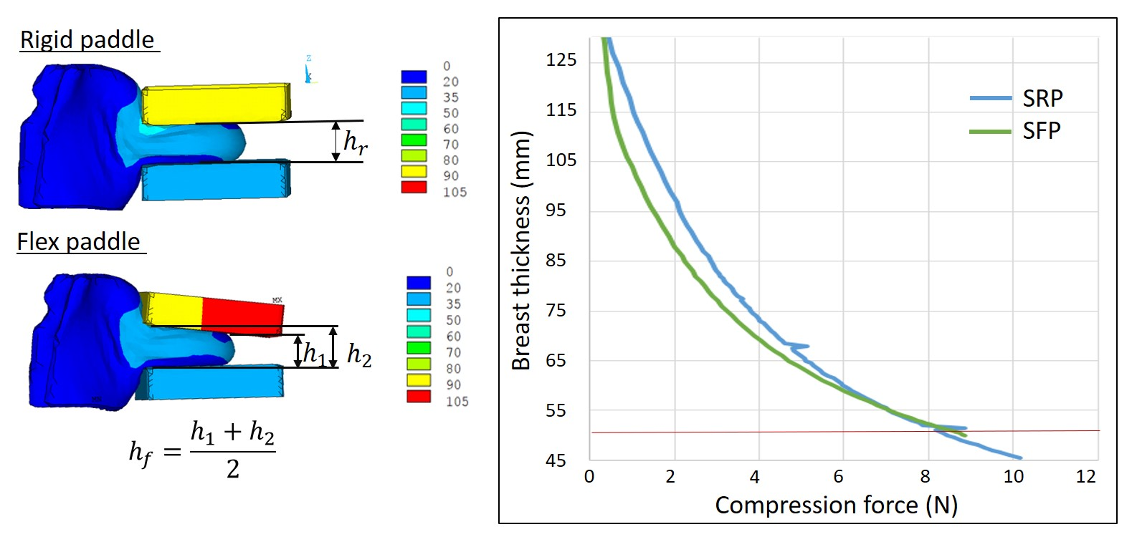
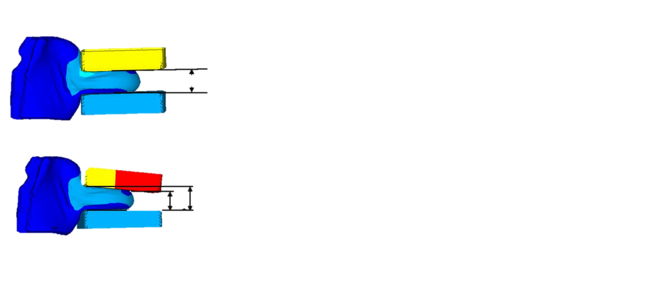

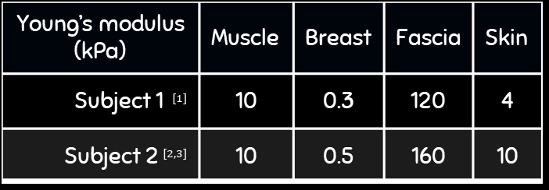




Constitutive models for breast compression
Constitutive models
Nearly-incompressible Neo – Hookean models Poisson ratio = 0.499
Breast flattening as function of the applied force.
Second volunteer – right breast
Young’s modulus (kPa) | Muscle | Breast | Fascia | Skin
Subject 1 $^{[1]}$ | 10 | 0.3 | 120 | 4
Subject 2$^{[2,3]}$ | 10 | 0.5 | 160 | 10
$$h_{SRP}$$
$$h_{2}$$
$$h_{1}$$
$$h_{SFP}=\frac{h_{1}+h_{2}}{2}$$
Model calibration step
Literature data
 | Subject 2
$$h_{SRP}$$ | 50 mm
F | 97.8 N
Compression force – 10 times lower
[1] Mîra, A., Carton, A. K., Muller, S., & Payan, Y. (2018). Breast Biomechanical Modeling for Compression Optimization in Digital Breast Tomosynthesis. In Computer Methods in Biomechanics and Biomedical Engineering (pp. 29-35). Springer, Cham.
[2] Gefen, A., & Dilmoney, B. (2007). Mechanics of the normal woman's breast. Technology and Health Care, 15(4), 259-271.
[3] Rajagopal, V. (2007). Modelling breast tissue mechanics under gravity loading (Doctoral dissertation, ResearchSpace@ Auckland).

Slide 9
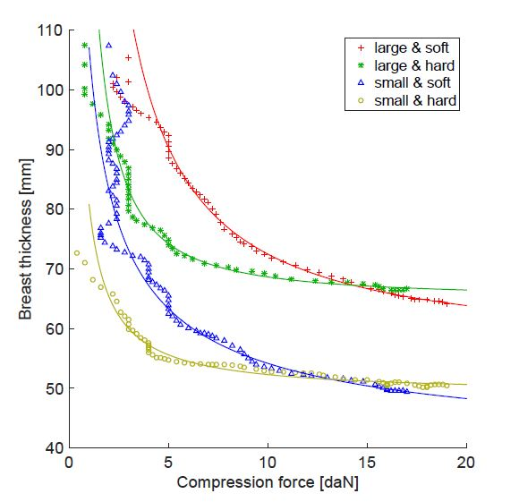
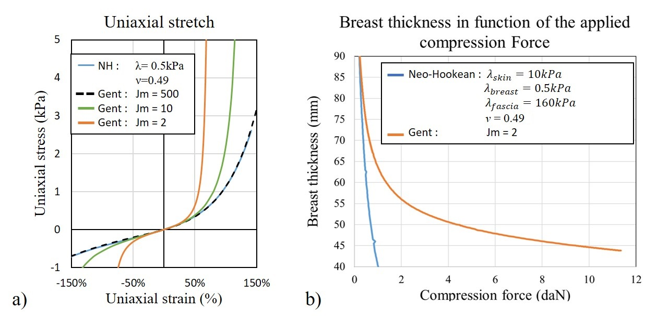

Constitutive models for breast compression
In-vivo measures
Gent constitutive model
In-vivo measured breast flattening curves as function of the applied force$^{[4]}$.
Simulated breast flattening curves as function of the applied force .
[4] de Groot, J. E., Branderhorst, W., Grimbergen, C. A., den Heeten, G. J., & Broeders, M. J. (2015). Towards personalized compression in mammography: a comparison study between pressure-and force-standardization. European journal of radiology, 84(3), 384-391.

Slide 10
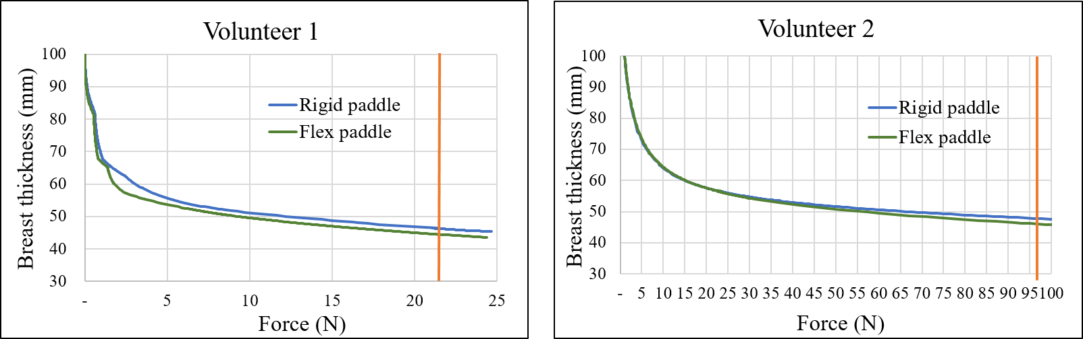


Constitutive models for breast compression
Constitutive models
Nearly-incompressible Gent models :
Poisson ratio = 0.499
Breast flattening as function of the applied force.
Young’s modulus (kPa) | Muscle | Breast | Fascia | Skin | Jm
Volunteer 1 | 10 | 0.3 | 120 | 4 | 1
Volunteer 2 | 10 | 0.5 | 160 | 10 | 2
 | Subject 1
$$h_{SRP}$$ | 47 mm
F | 41.9 N
Model calibration step
Literature data
 | Subject 2
$$h_{SRP}$$ | 50 mm
F | 97.8 N
[1] Mîra, A., Carton, A. K., Muller, S., & Payan, Y. (2018). Breast Biomechanical Modeling for Compression Optimization in Digital Breast Tomosynthesis. In Computer Methods in Biomechanics and Biomedical Engineering (pp. 29-35). Springer, Cham.
[2] Gefen, A., & Dilmoney, B. (2007). Mechanics of the normal woman's breast. Technology and Health Care, 15(4), 259-271.
[3] Rajagopal, V. (2007). Modelling breast tissue mechanics under gravity loading (Doctoral dissertation, ResearchSpace@ Auckland).

Slide 11
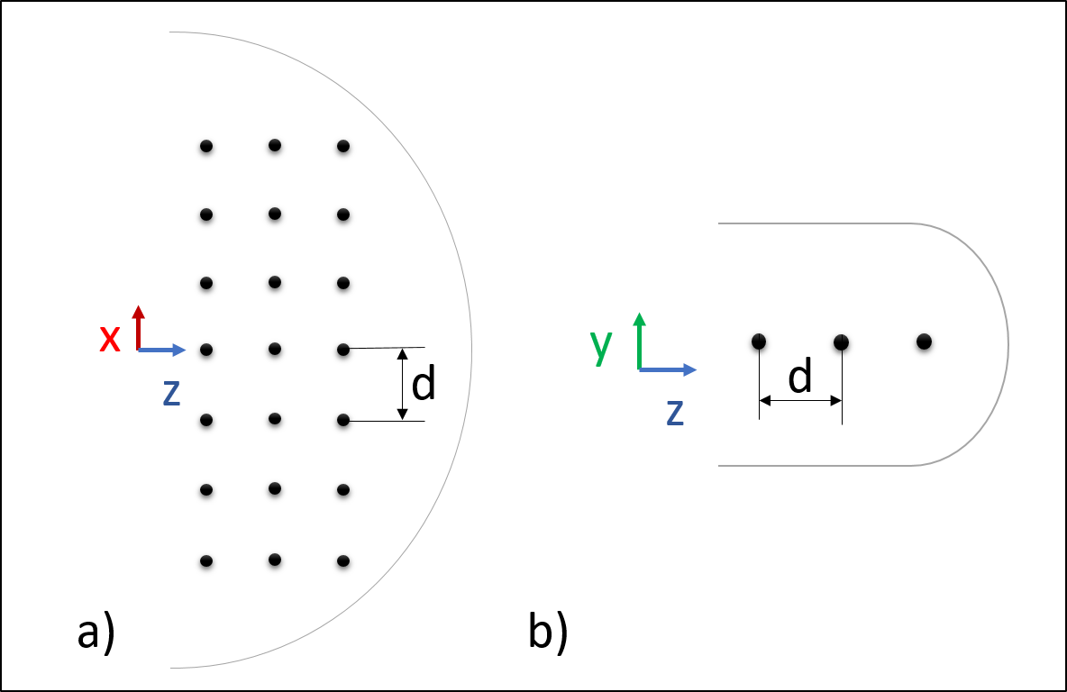
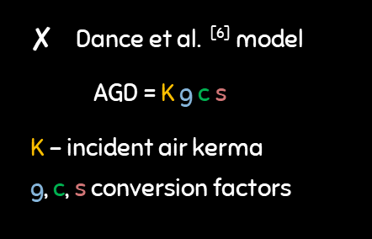
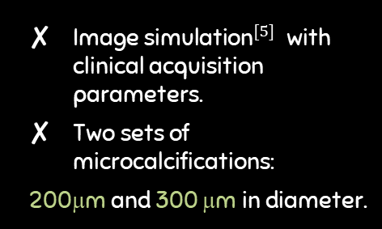
Breast compression quality metrics
Image quality
Average Glandular dose
Patient comfort
$\text{Image}{ \text{simulation}}^{[5]}$ with clinical acquisition parameters.
Two sets of microcalcifications:
200μm and 300 μm in diameter.
Dance et al. $^{\text{[}\text{6}\text{]}}$ model
AGD = K g c s
K – incident air kerma
g, c, s conversion factors
Strain/stress internal distribution.
Pressure at skin surface
SNR: background signal to noise ratio.
Clinical acquisition parameters.
Breast thickness
Homogeneous breast composition:
20% glandularity.
SDNR: µ-calc – background signal difference to noise ratio.
[5] de Carvalho, P. M. (2014). Low-Dose 3D Quantitative Vascular X-ray Imaging of the Breast (Doctoral dissertation, Université Paris Sud-Paris XI).
[6] Dance, D. R., Skinner, C. L., Young, K. C., Beckett, J. R., & Kotre, C. J. (2000). Additional factors for the estimation of mean glandular breast dose using the UK mammography dosimetry protocol. Physics in medicine & biology, 45(11), 3225.

Slide 12
Breast compression quality
Image Quality
Average glandular dose
SNR | Rigid paddle |  | Flex paddle
 | mean | std dev | mean | std dev | p-value
Vol 1 | 82.90 | 43.09 | 83.70 | 37.72 | 0.706
Vol 2 | 126.89 | 8.75 | 137.21 | 10.73 | 0.000
 | Force (N) | Rigid paddle |  | Flex paddle
 |  | BNT(mm) | AGD(mGy) | BNT(mm) | AGD(mGy)
Vol 1 | 22 | 46 | 1.15 | 44 | 1.12
Vol 2 | 95 | 48 | 1.20 | 46 | 1.15
200μm microcalcifications
SDNR | Rigid paddle |  | Flex paddle
 | mean | std dev | mean | std dev | p-value
Vol1 | 0.74 | 0.68 | 0.79 | 0.54 | 0.689
Vol2 | 1.14 | 0.57 | 1.13 | 0.53 | 0.885
For the two volunteers the flex paddles preserve or improve image quality compared to rigid paddles.
300μm microcalcifications
SDNR | Rigid paddle |  | Flex paddle
 | mean | std dev | mean | std dev | p-value
Vol 1 | 2.01 | 1.28 | 1.85 | 1.02 | 0.224
Vol 2 | 0.76 | 3.15 | 0.92 | 0.093 | 0.885
The compressed breast nominal thickness (BNT) and average glandular dose (AGD) are similar with both paddle types.

Slide 13
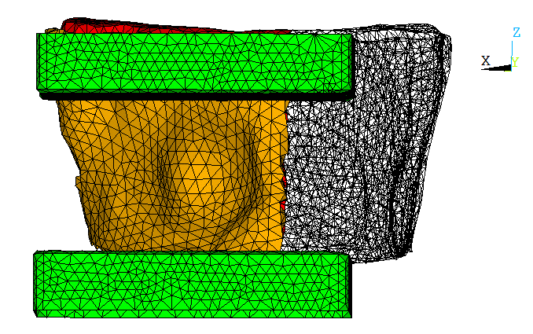
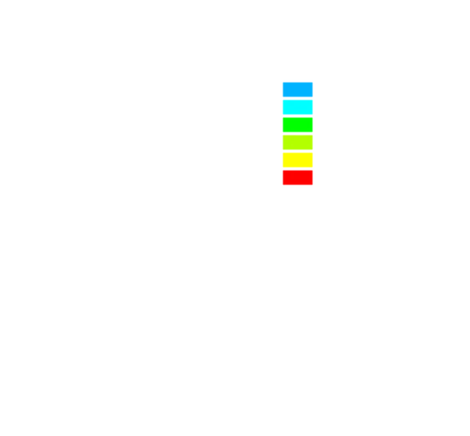
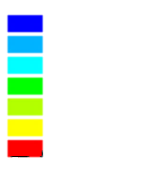
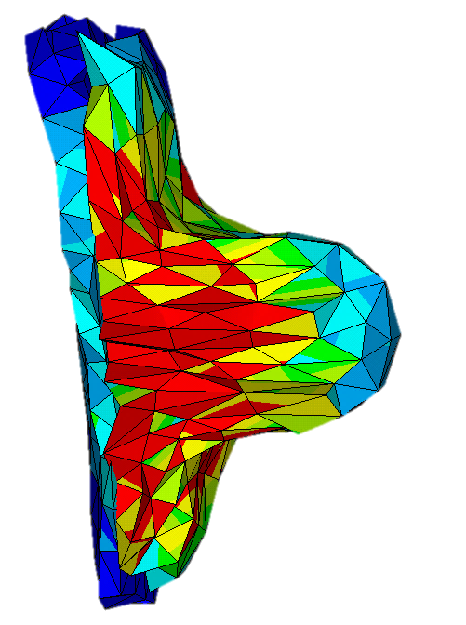
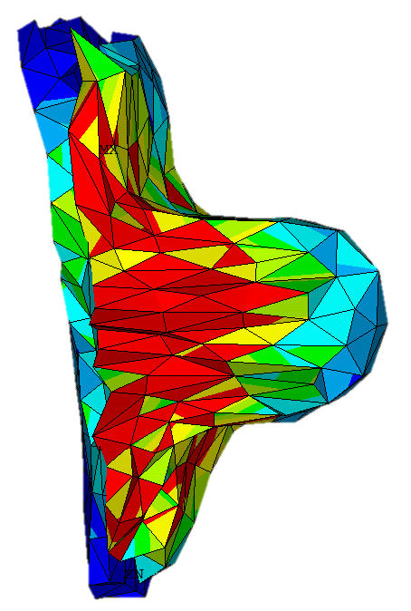
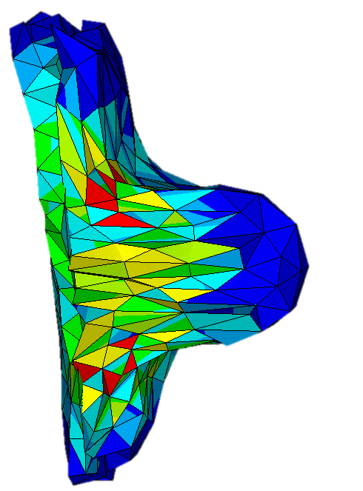
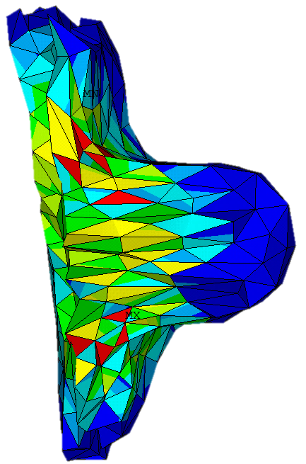
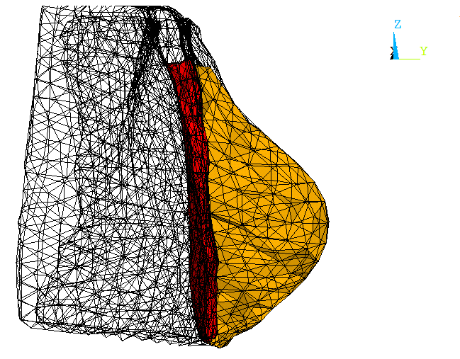

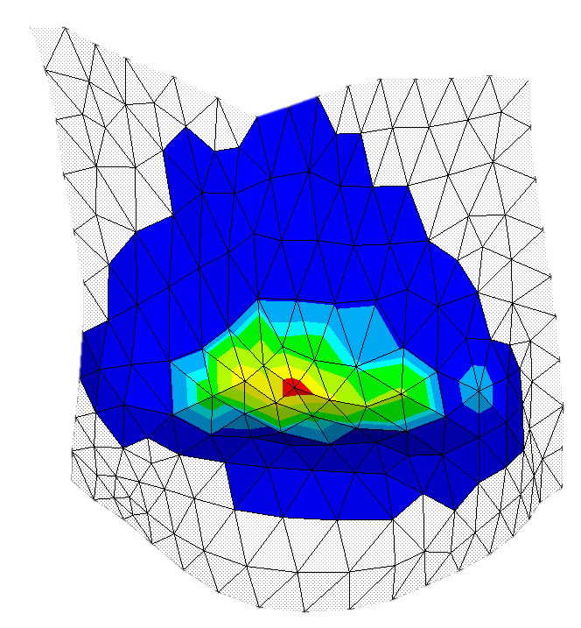

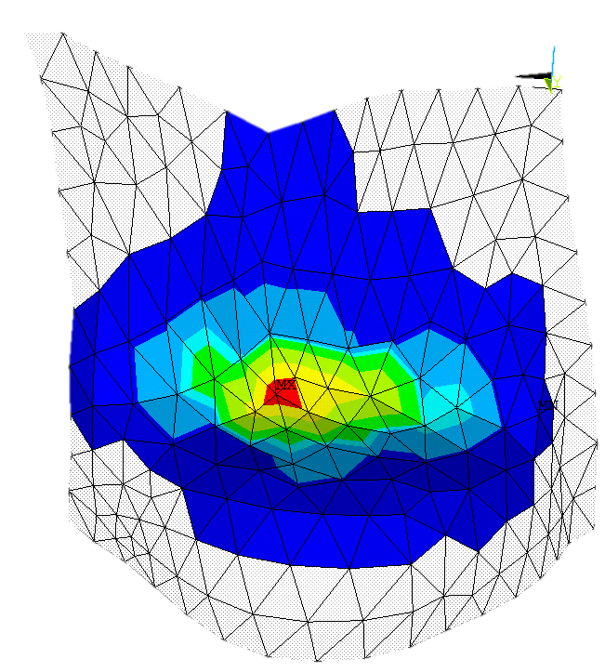
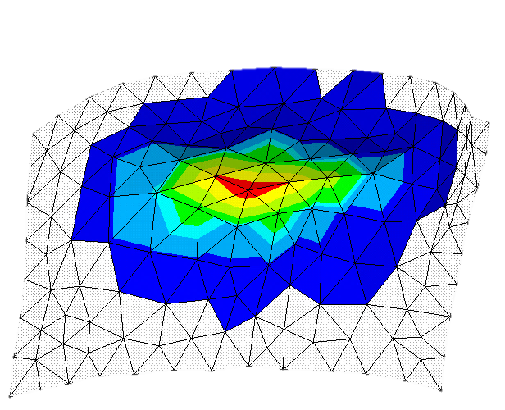
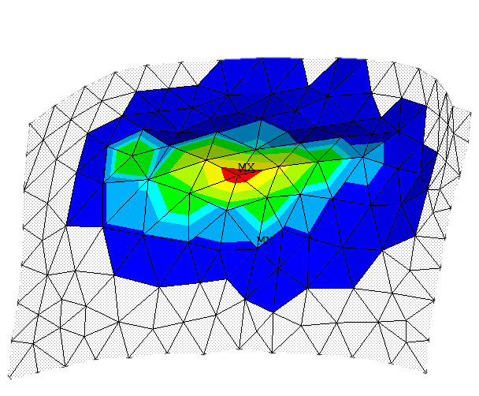
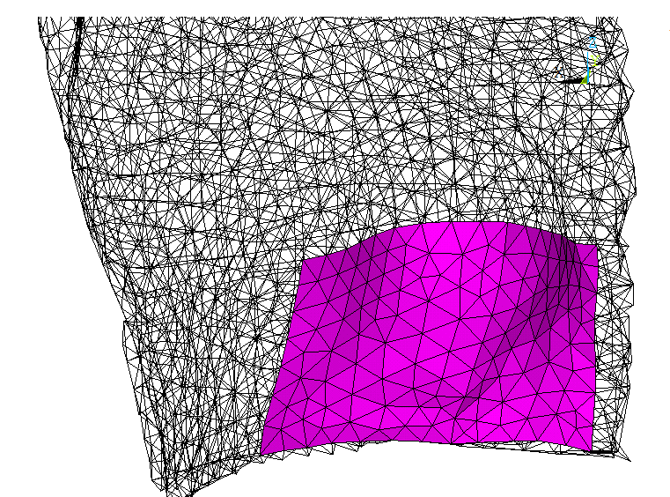
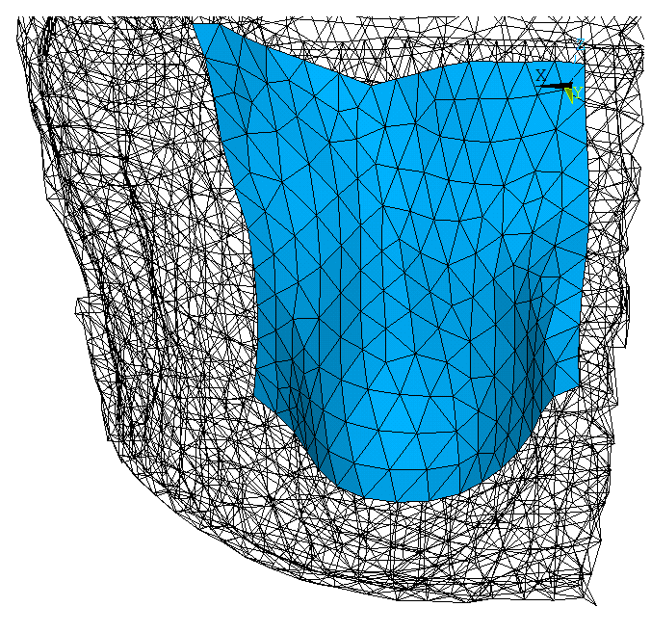
Breast compression quality
Subject 1 : patient comfort
Stress intensity
Strain intensity
0
0.5e-3
0.1e-2
0.003
0.006
0.01
0.05
0.17
MPa
0
0. 2
0. 4
0. 6
0. 7
0. 8
0. 9
1.
Skin pressure at receptor contact
Skin pressure at paddle contact
0
0. 01
0. 02
0. 03
0. 04
0. 06
0. 08
MPa
0
0. 01
0. 02
0. 03
0. 04
0. 06
0. 08
MPa

Slide 14
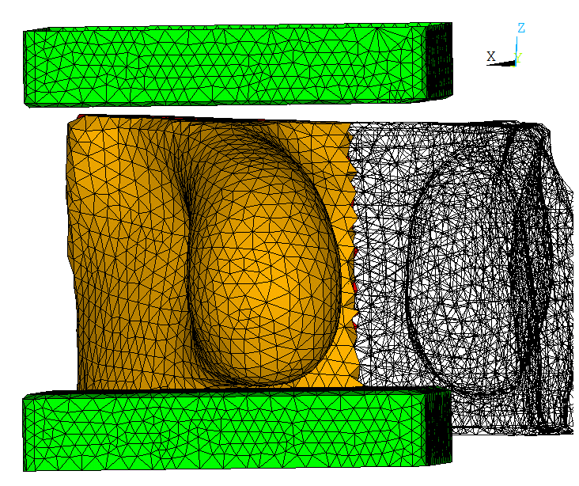
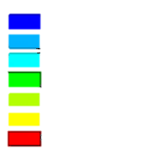
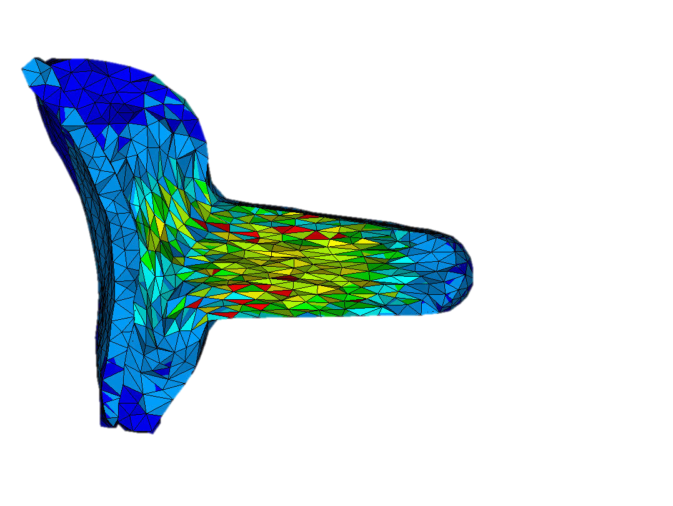
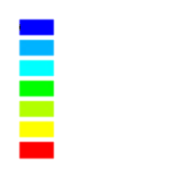
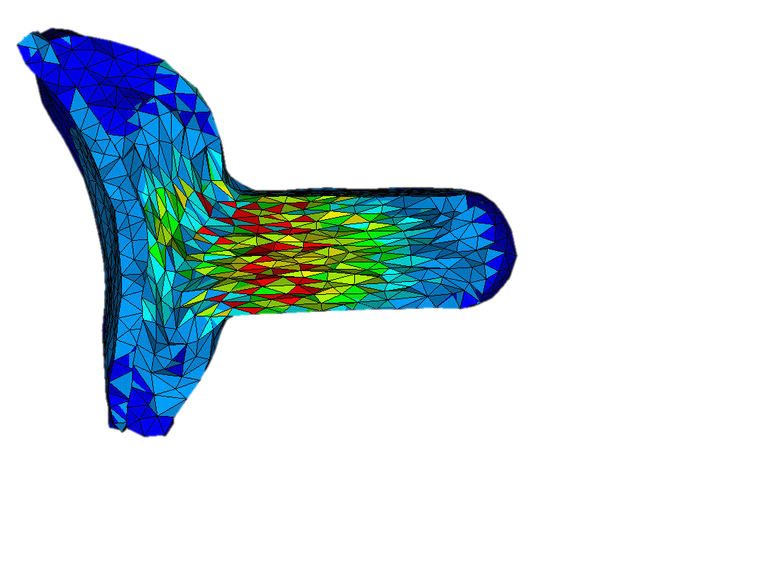











Breast compression quality
Subject 2: patient comfort
Stress intensity
Strain intensity
0
0.2e-3
0.2e-2
0.6e-2
0.01
0.02
0.03
0.5
MPa
0
0.4
0.6
0.8
1
1.2
1.3
1.4
Skin pressure at receptor contact
Skin pressure at paddle contact
0
0. 01
0. 02
0. 03
0. 04
0. 05
0. 06
MPa
0
0. 01
0. 02
0. 03
0. 04
0. 05
0. 06
MPa

Slide 15
Conclusion
For the small breast volume, the impact of the flex paddle on image quality, AGD or patient comfort is non significant.
For the large breast volume, the flex paddle leads to improved image quality and patient comfort, with no significant impact on AGD.

Slide 16
Outlook
Improve the soft tissue constitutive models .
Introduce breast heterogeneity and viscosity.
Apply the breast compression using a larger number of breast models.
Compare the compression results with a larger set of in-vivo measured data (Mammography or tomography images) .
Develop a new measure of AGD including variable breast thickness.

Slide 17
thanks!
Any questions?
You can find me at
anna.mira@univ-grenoble-alpes.fr

Slide 18

Stress-free breast geometry

Slide 19

Elastic parameters optimization

